Slide 1

AI ENGINEER ASSESSMENT — ROUND 1
Python Programming Q&A Assistant
Grounded answers from Stack Overflow · Powered by Gemini 2.5 Flash
TANIYA AGGARWAL

Slide 2


Problem Statement
GOAL
CHALLENGE
SOLUTION
DATASET
Build an AI-powered Q&A system for data science learners — accurate Python answers at their fingertips.
LLMs hallucinate — learners need grounded answers backed by real community knowledge, not AI guesses.
RAG pipeline: retrieve the most relevant Stack Overflow posts first, then generate the answer strictly from that context.
Stack Overflow Python Q&A (Kaggle) — 50K+ high-quality Q&A pairs filtered by community score ≥ 5.
CONSTRAINT: Zero hallucination — prompt explicitly instructs: "Answer ONLY from the provided context. No outside knowledge."

Slide 3
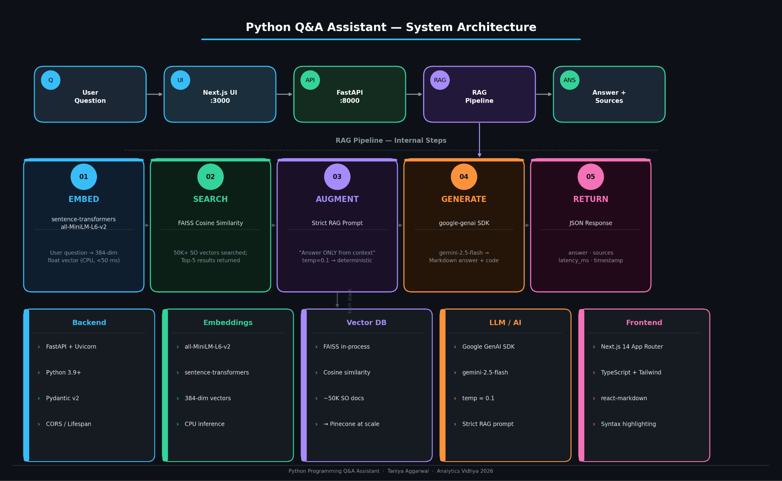
System Architecture
A clean design coupling decoupled layers via clear API contracts:
User Engine: Submits raw query via browser client.
Next.js UI (:3000): Renders intuitive chat streams & source validation.
FastAPI Server (:8000): Non-blocking high-performance service router.
RAG Pipeline Orchestration: Connects vector mapping directly to foundational context generation.
Payload Target: Synchronizes deterministic answer along with reference metadata.

Slide 4

RAG Pipeline — Internal Steps
1
2
3
4
5
EMBED
SEARCH
AUGMENT
GENERATE
RETURN
sentence-transformers all-MiniLM-L6-v2 384-dim vectors
FAISS cosine similarity Top-5 most relevant SO Q&A pairs
Inject context into strict RAG prompt Temp = 0.1
google-genai SDK Gemini 2.5 Flash Markdown answer
answer + sources + latency_ms + timestamp

Slide 5


Tech Stack
Backend
RAG & AI
Frontend
Dataset & Infra
FastAPI + Uvicorn — async REST API
LangChain — retrieval orchestration only
Next.js 14 App Router + TypeScript
Stack Overflow Python Q&A (Kaggle)
Python 3.9+, Pydantic v2 validation. Lifespan startup events (pipeline loads once). Full CORS support for frontend.
FAISS — in-process vector similarity search. sentence-transformers all-MiniLM-L6-v2 (CPU). Google GenAI SDK — gemini-2.5-flash (direct).
Tailwind CSS — dark-first design system. react-markdown + react-syntax-highlighter. Source cards, latency display, copy buttons.
50K+ pairs, score ≥ 5, HTML-cleaned. FAISS index — 384-dim cosine similarity. Dockerfile ready for HF Spaces / Render.

Slide 6
RAG Pipeline — How It Works
01 RETRIEVE
—
Question embedded via sentence-transformers all-MiniLM-L6-v2 → 384-dim vector
—
FAISS cosine similarity search across all indexed Stack Overflow Q&A pairs
—
Returns Top-5 most semantically relevant posts as retrieval context
02 AUGMENT
—
Retrieved context formatted as numbered sources and injected into prompt
—
Strict instruction: "Answer ONLY from the context — no outside knowledge allowed"
—
Temperature = 0.1 → low randomness → factual, grounded, deterministic answers
03 GENERATE
—
google-genai SDK sends the full prompt directly to Gemini 2.5 Flash (no LangChain LLM)
—
Gemini returns a markdown-formatted answer with properly formatted code blocks
—
Sources (title, score, snippet) returned alongside answer for full transparency

Slide 7
Test Results — 10 / 10 Pass
10/10
14/14
3.33s
100%
QUERIES PASSED
UNIT TESTS
AVG LATENCY
PASS RATE
# | Category | Question | Latency | Result
1 | Basic Ops | How do I reverse a list in Python? | 3409ms | ✓ PASS
2 | Data Structures | What is the difference between list and tuple? | 2625ms | ✓ PASS
3 | Functional | How do list comprehensions work in Python? | 4027ms | ✓ PASS
4 | File I/O | How do I read a file line by line? | 4317ms | ✓ PASS
5 | OOP | How do I use decorators in Python? | 4384ms | ✓ PASS

Slide 8
Scaling to 100+ Concurrent Users
Concern | Current State | At 100+ Users — Solution
⚡ Latency | ~3.3s avg, single Uvicorn worker | Multiple workers + Nginx LB + streaming SSE → <1s perceived UI latency
🔍 Vector Search | FAISS in-process (in-memory) | Pinecone / Qdrant — distributed, persistent, rock-solid sub-10ms search profile
🤖 LLM Calls | Synchronous, one per request | Async batch execution execution pipeline + Gemini prompt caching → up to 75% cost reduction
💾 Caching | None — every query hits Gemini | Redis semantic cache system — repeated answers served instantly, target ~40% hit rate
👁 Observability | Basic stdout standard logging | LangSmith LLM tracing + Datadog APM metrics + structured JSON application logs

Slide 9



Estimated Cost @ 100K queries / day
Gemini 2.5 Flash
With Redis Cache
Pinecone Serverless
~$30/day
~$18/day
~$10/day
$0.0003 base rate calculation metric per individual user query × 100K daily volume.
Derived via ~40% cache hit architecture assumption, passing direct matching savings back to operations.
Flat cost calculated on standard scaling vectors of approximately $0.10 per 1M vectors queried.

Slide 10
Key Decisions & Next Steps
Key Design Decisions
Next Strategic Steps
—
google-genai SDK directly: Native connection over abstractions like LangChain LLM wrappers for speed and transparency.
—
Deploy to Hugging Face Spaces: Port docker parameters out to live sandbox host environments.
—
Ingest full 50K Kaggle dataset: Complete population transition out from testing benchmarks.
—
sentence-transformers on CPU: Clean sub-second matching with zero infrastructure overhead dependencies.
—
Streaming Server-Sent Events: Optimize real-time token rendering speeds down to milliseconds.
—
FAISS in-process: Rapid evaluation build footprint; seamlessly ready to swap to enterprise Pinecone indices.
—
Continuous Implicit Feedback Loops: Establish diagnostic quality telemetry tracking parameters.
—
Strict 0.1 Temperature: Eradicates common text engine deviations to yield pure factual integrity.
—
Multi-turn context tracking: Expand retrieval logic across consecutive context layers.
—
Pydantic v2 data validations: Strong contracts preventing silent ingestion validation drops.

